Slide 1
Backend Engineering-I
Registration Form
Aniket Singla, 2310992100
Ankit Bansal,2310992106
Ketan Sharma, 2310992120
Vihaan Chawla, 2310991319
Class Group: G24
Department of Interdisciplinary Courses in Engineering

Slide 2
Introduction
Objective:
To develop a registration form with a backend system for storing and managing user data.
Key Features:
Frontend form validation.
Backend data storage in a JSON file.
Dynamic display of registered users.

Slide 3
Technologies Used
Frontend: HTML, CSS, JavaScript
Backend: Node.js
Data Storage: JSON
Tools: Visual Studio Code, Browser

Slide 4
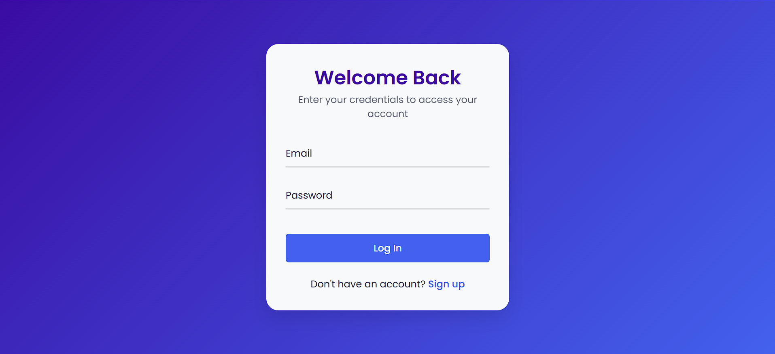
Workflow
User Input: Data is entered into the registration form

Slide 5
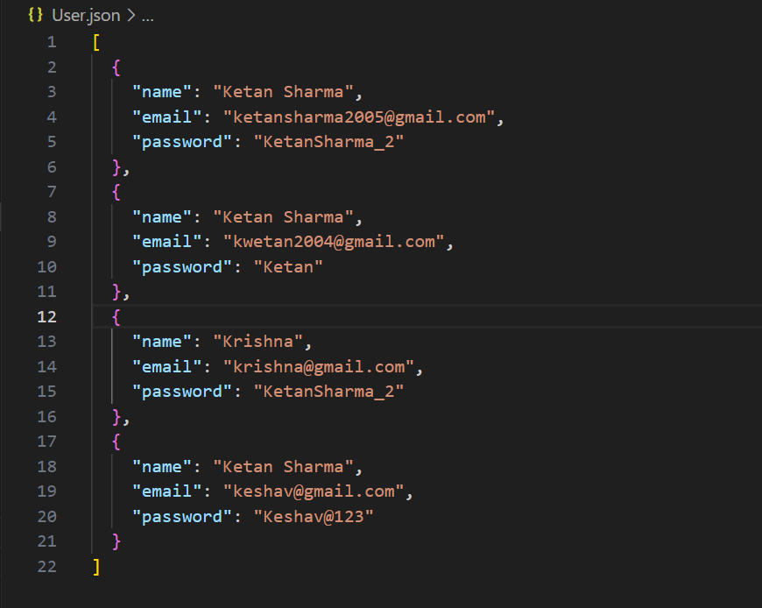
Workflow
Data Submission: On form submission, data is sent to the backend.
Storage: Backend writes the user data into a user.json file.

Slide 6
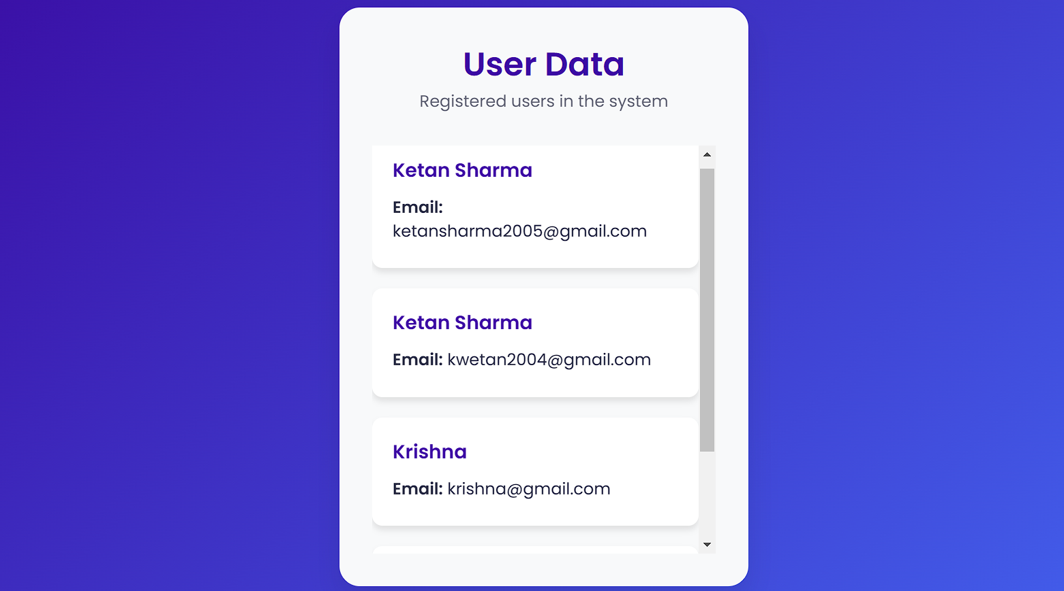
Workflow
Display: Data from user.json is dynamically rendered on the "All Students" page.

Slide 7
Challenges Faced
Managing state between frontend and backend.
Ensuring proper validation and error handling.
Updating and rendering data dynamically.

Slide 8
Future Enhancements
Add user authentication (login/logout system).
Integrate a database like MongoDB or MySQL.
Improve UI/UX with better design frameworks.
Implement filters for the student list.

Slide 9
Conclusion
Successfully implemented a registration system with a backend and JSON data handling.
Demonstrated the ability to manage user data dynamically and display it effectively.

Slide 10
Thank You

